Slide 1
Plasmodium Species (Malaria)
Nosyreva Svetlana, assistant professor
of epidemiology and infectious diseases department

Slide 2
Definition. Etiology.
Malaria is an acute, febrile disease transmitted by the female Anopheles mosquito and is caused by protozoan parasite Plasmodium spp.
Five Plasmodium species cause human infection:
- P. falciparum occurs in Africa, Papua New Guinea, Haiti and East Asia, can invade red blood cells of all ages, may be drug-resistant and is responsible for most severe, life-threatening infections;
- P. vivax (occurs in Central and South America, India, North Africa and East Asia) and P. ovale (occurs in West Africa) cause clinically similar, milder infections. They produce hypnozoites and may cause relapse months after the initial infection;

Slide 3
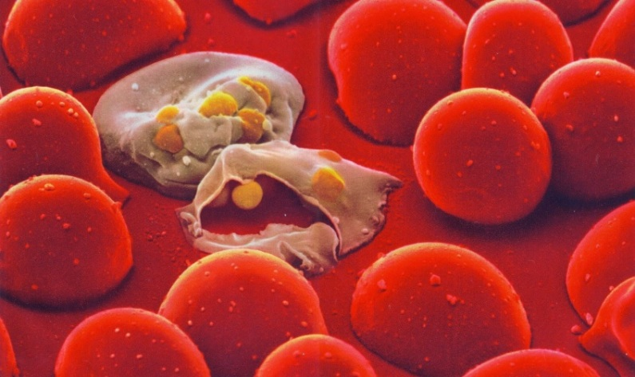
Definition. Etiology.
- P. malaria (occurs mostly in Africa) rarely causes acute illness in normal hosts, doesn’t produce hypnozoites but may persist in the bloodstream for years;
- P. knowlesi (occurs in Southeast Asia) causes malaria in macaques and has recently been recognized as a cause of human malaria. Microscopically it resembles P. malariae but can cause fatal disease (like P. falciparum).
P. falciparum and P. vivax account for 95% of the malaria.

Slide 4
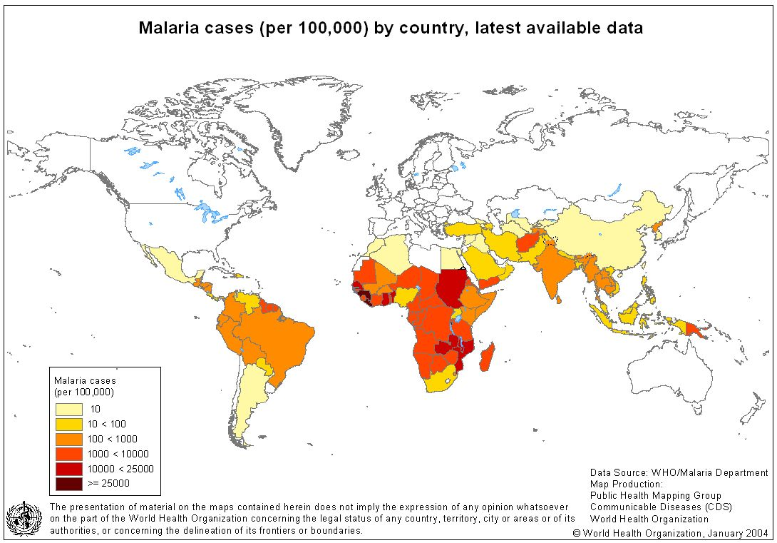
Epidemiology.
Every year 300-500 million people suffer from this disease and 1,5-3,0 million die (mostly children).
Malaria occurs throughout most of the tropical regions of the world and affects people in more than 100 countries.
Malaria is mainly transmitted via the bite of a female Anopheles spp. mosquito.
Other comparatively rare mechanisms for transmission include:
congenitally-acquired disease, blood transfusion, sharing of contaminated needles in intravenous drug usage and organ transplantation.

Slide 5
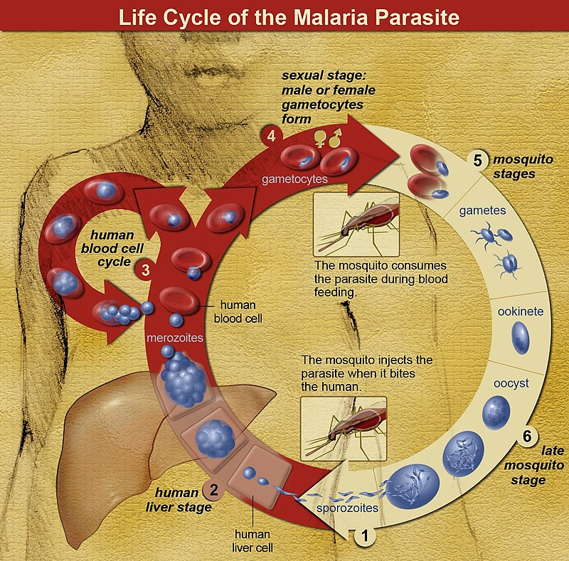
Life cycle.
Human infection begins when an anopheline mosquito
inoculates plasmodial sporozoites from its salivary
gland during a blood meal.
Motile sporozoites are carried rapidly via the bloodstream
to the liver where they invade hepatic parenchymal cells
and begin a period of asexual reproduction (intrahepatic
or preerythrocytic schizogony or merogony). By this
amplification process a single sporozoite eventually may
produce from 10,000 to >30,000 daughter merozoites.
In P. vivax and P. ovale infections, a proportion of the intrahepatic forms do not divide immediately but remain dormant for a period ranging from 3 weeks to a year or longer before reproduction begins. These dormant forms, or hypnozoites, are the cause of the late relapses.

Slide 6
Life cycle.
The swollen infected liver cell eventually bursts,
discharging motile merozoites into the bloodstream.
These then invade the red blood cells (RBCs),
become trophozoites and multiply six- to twentyfold
every 48–72 h. By the end of the 48-h intraerythrocytic
life cycle (72 h for P. malariae), the parasite has
consumed nearly all the hemoglobin and grown to
occupy most of the RBC. It is now called a schizont.
Multiple nuclear divisions have taken place (schizogony or merogony) and the RBC then ruptures to release 6–30 daughter merozoites, each potentially capable of invading a new RBC and repeating the cycle.

Slide 7
Life cycle.
After a series of asexual cycles (P. falciparum)
or immediately after release from the liver (P. vivax,
P. ovale, P. malariae) some of the parasites develop
into morphologically distinct, longer-lived sexual forms
(gametocytes) that can transmit malaria.
After being ingested in the blood meal of a biting
female anopheline mosquito the male and female
gametocytes form a zygote in the insect’s midgut.
The resulting oocyst expands by asexual division until it bursts
to liberate myriad motile sporozoites, which then migrate in the hemolymph to the
salivary gland of the mosquito to await inoculation into another human at the next
feeding.

Slide 8
Pathogenesis.
After the merozoites invade the red blood cells they cause hemolysis of parasitized red blood cells that activates cytokines.
There are some additional mechanisms that contribute to the pathogenesis of severe Plasmodium falciparum malaria:
cytoadherence – adherence of parasitized red blood cells to the vascular endothelium is mediated by P.falciparum-infected erythrocyte membrane protein 1 (PfEMP1), which binds to specific endothelial receptors (thrombospondin, CD 36).
This results in periferal sequestration of parasites which protects them from removal from the circulation as they pass through the spleen and oxidant damage as they pass through the lungs;
- rosetting – PfEMP1 also binds to complement receptor-1 resulting in clustering of unparasitized red cells around parasitized red cells;
hyperparasitaemia (>5%) is associated with a greater risk of death, particularly in non-immune patients.
Reasons for this include more over metabolic effects (hypoglycaemia and lactic acidosis).

Slide 9
Clinical features.
Malaria is a very common cause of fever in tropical countries.
The first symptoms of malaria are nonspecific (headache, fatigue, abdominal discomfort and muscle aches) followed by fever are all similar to the symptoms of a respiratory viral illness.
In some instances a prominence of headache, chest pain, abdominal pain, arthralgia, myalgia or diarrhea may suggest another diagnosis.
Although headache may be severe in malaria there is no neck stiffness or photophobia resembling that in meningitis.
While myalgia may be prominent it is not usually as severe as in dengue fever and the muscles are not tender as in leptospirosis or typhus.
Nausea, vomiting, and orthostatic hypotension are common.

Slide 10
Signs and Symptoms
Generalized illness:
Fever, chills (a cyclic pattern of febrile episodes may emerge with persistent fevers, commonly repeating every 2–3 days)
Headache
Myalgias, weakness
Cough, vomiting, diarrhea
Abdominal pain
Hepatosplenomegaly
Altered mental status (cerebral infection,universally fatal if untreated)
Advanced disease:
Acute renal failure
Generalized convulsions
Cardiovascular compromise
Coma

Slide 11
Clinical features.
The classic malarial paroxysms includes 3 stages:
1. “cold or chilling stage” – severe chills;
2. “hot stage” – high temperature;
3. “sweating stage” – resolution of fever, intense sweat and fatigue.
Malarial paroxysms occur at regular intervals are relatively unusual and
suggest infection with P. vivax or P. ovale (tertian - fever spikes evere 2 days) or
P. malaria (quartan - fever spikes every 3 days).
The fever is always irregular in P. falciparum malaria.

Slide 12
Clinical features.
In nonimmune individuals with acute malaria the spleen takes several days
to become enlarged.
Slight enlargement of the liver is also common.
Mild jaundice is common among adults; it may develop in patients with otherwise uncomplicated falciparum malaria and usually resolves over 1–3 weeks.
Complications of malaria:
cerebral malaria,
pulmonary edema,
severe anaemia,
hypoglycaemia,
uraemia,
lactic acidosis.

Slide 13
Cerebral malaria
Cerebral malaria is a syndrome characterized by diminished consciousness and/or seizures.
In endemic areas, it typically occurs in young children and can manifest clinically as varying levels of consciousness, obtundation or coma, or seizures. Seizures may be clinically inapparent, subtle motor, partial motor, generalized tonic-clonic, or partial motor with secondary generalization.
Multiple factors can contribute to cerebral malaria: hypoglycemia, acidosis, hyperpyrexia, the post-ictal state, and effects of anticonvulsant medication.
In endemic areas, there may also be considerable overlap in the clinical presentations of cerebral malaria and other syndromes such as bacterial or viral meningitis, subdural hematoma, or sepsis.
Although cerebral malaria commonly resolves without neurological sequel, some children (especially those with status epilepticus) may develop psychosis, cerebellar ataxia, extrapyramidal rigidity, hemiplegia, or long-term cognitive and language impairment.

Slide 14
Severe anemia
The anemia associated with malaria is multifactorial and is usually associated with P falciparum infection.
In nonimmune patients, anemia may be secondary to erythrocyte infection and a loss of infected RBCs.
In addition, uninfected RBCs are inappropriately cleared, and bone marrow suppression may be involved.

Slide 15
Renal failure
This is a rare complication of malarial infection.
Infected erythrocytes adhere to the microvasculature in the renal cortex, often resulting in oliguric renal failure.
Renal failure is typically reversible, although supportive dialysis is often needed until kidney function recovers.
In rare cases, chronic P. malariae infection results in nephrotic syndrome.
Hemoglobinuria manifests as dark colored urine (“blackwater fever”), distinct from the red appearance of hematuria.

Slide 16
Respiratory symptoms
Respiratory distress is characterized by dyspnea or deep breathing (Kussmaul’s respiration), which may be accompanied by nasal flaring or intercostal retraction.
Patients with malaria may develop metabolic acidosis and associated respiratory distress.
In addition, pulmonary edema can occur.
Signs of malarial hyperpnoea syndrome include alar flaring, chest retraction (intercostals or subcostal), use of accessory muscles for respiration, or abnormally deep breathing.

Slide 17
Differential Diagnosis of the Malaria Presentation:
Influenza
Enteric fever
Bacteremia/sepsis
Classic dengue fever
Acute schistosomiasis (Katayama fever)
Leptospirosis
African tick fever
East African trypanosomiasis (sleeping sickness)
Yellow fever

Slide 18
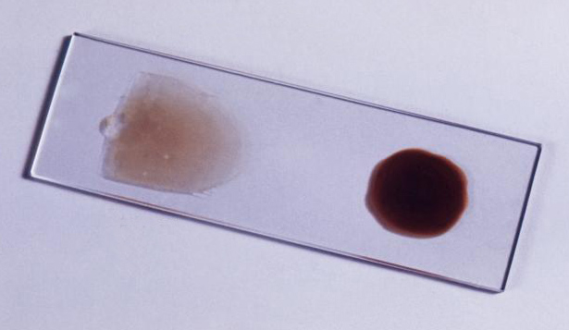
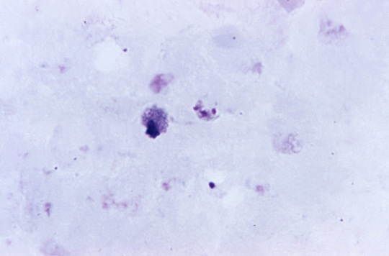
Laboratory diagnosis.
Initial examination: anemia, thrombocytopenia, increased lactate dehydrogenase and reticulocytes.
Confirmatory tests:
1. Blood Smear:
- a study of a thick drop of blood (erythrocytes in such a preparation are lysed; leukocytes and malarial plasmodia change their shape somewhat, which makes them difficult to differentiate) - is used to determine the presence of malaria and count the number of parasites.

Slide 19
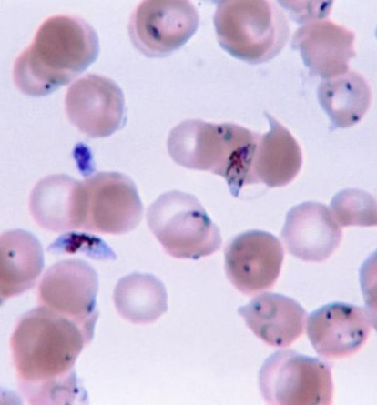
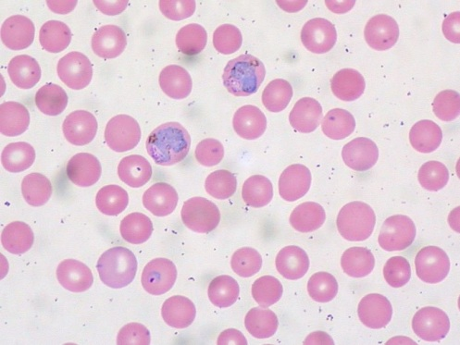
Laboratory diagnosis.
Confirmatory tests:
1. Blood Smear:
- a thin smear (erythrocytes remain intact, plasmodia are practically not deformed and are determined in erythrocytes)
2. rapid dipstick tests targeting malaria antigens (these tests detect plasmodial lactate dehydrogenase, some of them enable distinction of species);
3. polymerase chain reaction (PCR) and other molecular techniques (not widely available).

Slide 20
Treatment GENERAL PRINCIPLES
P. falciparum malaria can be fatal if not diagnosed and treated promptly and appropriately. This is especially true of nonimmune travelers returning from visits to malaria-endemic areas.
Malaria is a disease of protean manifestations.
Its diagnosis can be delayed by the nonspecificity of the clinical presentation and routine laboratory tests, especially if blood smears are not examined.
Life-threatening manifestations of malaria such as seizures, hypoglycemia, and pulmonary edema may develop rapidly in patients who appear relatively well at presentation or appear to respond initially to antimalarial drugs.

Slide 21
Treatment GENERAL PRINCIPLES
Although some patients with uncomplicated P. falciparum malaria can be treated successfully in an outpatient setting, patients with no immunity against the disease are at increased risk for sudden development of severe complications and should be hospitalized at least 48 hours to ensure adequate response to therapy, regardless of how well they appear at presentation.
Hospitalization is likewise recommended for individuals from malaria-endemic countries but whose immune status nevertheless cannot be known with certainty.
Patients with P. vivax, P. ovale, or P. malariae malaria infrequently require hospitalization, though it is certainly necessary in cases with severe manifestations.
Patients with P. knowlesi malaria may require hospitalization as life-threatening manifestations of disease can develop rapidly.

Slide 22
Treatment GENERAL PRINCIPLES
Uncomplicated malaria can be treated with oral medication as long as the patient is able to retain the drug; directly observed therapy may be appropriate in some cases to ensure adequate treatment.
Important adjunct treatment of malaria includes antipyretic, antiemetic, and anticonvulsant medications.
Because of the widespread patterns of drug resistance in the world today, no blanket recommendation suffices and alternatives must be considered when selecting an antimalarial drug.

Slide 23
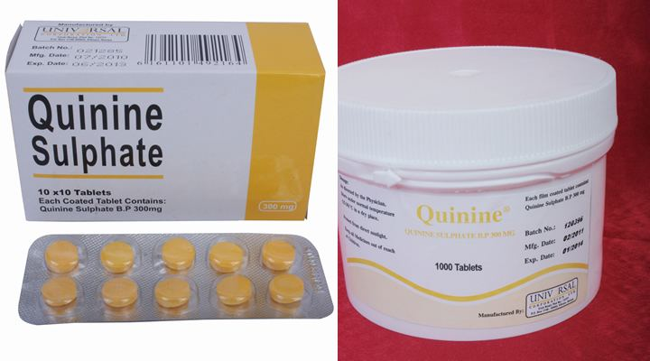
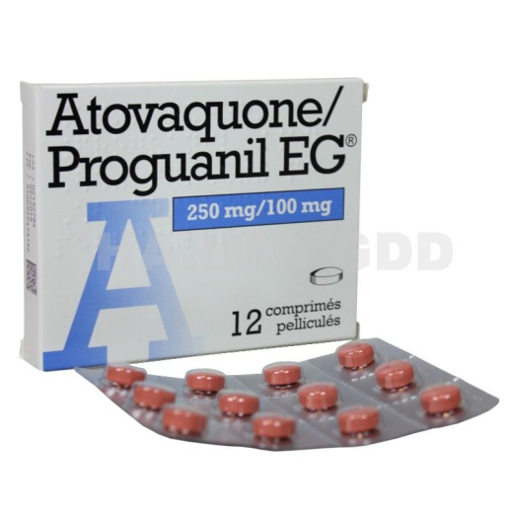
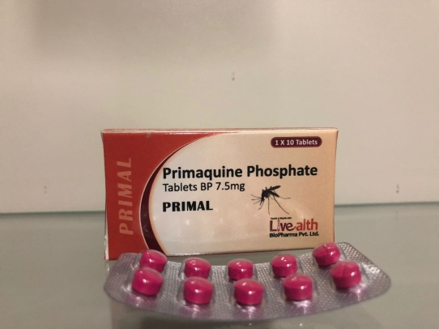
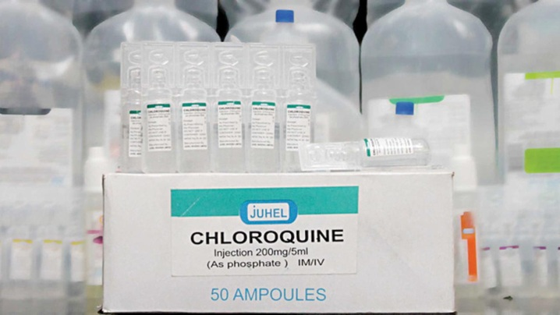
Antimalarial drugs
Etiotropic therapy, depending on the effect on the different stages of development of malarial plasmodium, 4 groups of drugs are distinguished:
blood schizontocides - destroy plasmodia in red blood cells, warning or terminating the clinic: chloroquine, quinine, quinidine, mefloquine, halofantrine, sulfonamides, tetracyclines
tissue schizontocides - destroy exoeriitrocytic forms of plasmodia in the liver: primaquine, proguanil, pritamine
gametocides - destroy the sexual forms of plasmodia in erythrocytes (primaquine)
hypnozoitocides - kill P. vivax and P. ovale hypnozoites in hepatocytes (primaquine)

Slide 24
Drugs currently recommended for the treatment of uncomplicated malaria are listed in Table
Drug | Adult Dose | Pediatric Dose | Precautions
Uncomplicated malaria: P. vivax, P. ovale, P. malariae, P. knowlesi,or chloroquine-susceptible P. falciparum
Chloroquine phosphate Supplied in 300-mg base (500-mg salt) tablets. | 600 mg base (1000 mg salt),then 300 mg base (500 mg salt) at 6, 24, and 48 hours. | 10 mg base/kg (max. 600 mg base),then 5 mg base/kg at 6, 24, and 48 hours. | None
Uncomplicated malaria: chloroquine-resistant P. falciparum or chloroquine-resistant P. vivax
Mefloquine Supplied in 250-mg salt (228-mg base) tablets. | 750 mg salt,followed by 500 mg 6-12 hours later. | <45 kg: 15 mg salt/kg, followed by 10 mg salt/kg 6-12 hours later. | Do not administer to individuals with cardiac conduction abnormalities, history of seizures, or serious psychiatric illnesses (e.g., psychosis, major depression). Do not use concomitantly with quinidine, quinine, or halofantrine

Slide 25
Drugs currently recommended for the treatment of uncomplicated malaria are listed in Table
Drug | Adult Dose | Pediatric Dose | Precautions
Quinine sulfate plus doxycycline Quinine sulfate supplied in 325-mg salt tablets. Doxycycline supplied in 100-mg tablets. | Quinine 650 mg salt every 8 hours for 3 days*plus doxycycline 100 mg twice daily for 7 days. | Children 8-12 years old: Quinine 10 mg salt/kg every 8 hours for 3 days*plus doxycycline 2 mg/kg every 12 hours for 7 days. Children <8 years old: Quinine 10 mg salt/kg every 8 hours for 7 days. | Do not use doxycycline in children below the age of 8 years or in pregnant women.
Atovaquone-proguanil (Malarone) Supplied in fixed-dose combination tablets containing 250 mg atovaquone and 100 mg proguanil (adult tablets) or 62.5 mg atovaquone and 25 mg proguanil (pediatric tablets). | Four adult tablets daily for 3 days (may be administered as 2 tablets twice daily). | The number of pediatric or adult tablets taken daily for 3 days depends on patient’s weight: 5-8 kg (2 pediatric tabs), 9-10 kg (3 pediatric tabs), 11-20 kg (1 adult tab), 21-30 kg (2 adult tabs), 31-40 kg (3 adult tabs), >40 kg (4 adult tabs). | Not recommended for chloroquine resistant P. vivax due to inadequate efficacy data. Safety in pregnant or breast feeding women is not established

Slide 26
Drugs currently recommended for the treatment of uncomplicated malaria are listed in Table
Drug |  | Adult Dose | Pediatric Dose |  |  | Precautions
Artemether plus lumefantrine Supplied in fixed-combination tablets containing 20 mg artemether and 120 mg lumefantrine. |  | 6-dose regimen: 1st day: 4 tabs initially, then 4 tabs 8 hours later, 2nd day: 4 tabs twice daily, 3rd day: 4 tabs twice daily. | The number of tablets per dose taken according to adult time schedule depends on patient’s weight |  |  | Safety in pregnant or breastfeeding women is not established.
Severe P. falciparum malaria (or severe P. knowlesi malaria)
Quinidine gluconate | Intravenous: 10 mg salt/kg loading dose (max. 600 mg) in normal saline infused slowly at a constant rate over 1-2 hours, followed by continuous infusion of 0.02 mg salt/kg/min for at least 24 hours and then until parasitemia <1% and oral therapy can be started. |  |  | Intravenous: same dosing as for adult. | Do not administer as a bolus. Check blood glucose every 4-6 hours during first 24 hours of therapy. Administer 5%-10% dextrose along with quinidine to reduce risk of hypoglycemia. Monitor levels to keep between 3-8 µg/mL.

Slide 27
Drugs currently recommended for the treatment of uncomplicated malaria are listed in Table
Drug | Adult Dose | Pediatric Dose | Precautions
Artesunate | Intravenous: artesunate 2.4 mg/kg, then 2.4 mg/kg at 12, 24, and 48 hours. | Intravenous: artesunate 2.4 mg/kg, then 2.4 mg/kg at 12, 24, and 48 hours. | None
Quinine dihydrochloride | Intravenous: 20 mg/kg loading dose in 5% dextrose infused slowly at a constant rate over 4 hours, followed by maintenance dose 10 mg/kg over 3-4 hours at 8-hour intervals (max. 1800 mg/d) until oral therapy can be started. | Intravenous: 20 mg/kg loading dose in 5% dextrose infused slowly at a constant rate over 4 hours, followed by maintenance dose 10 mg/kg over 3-4 hours at 8-hour intervals (max. 1800 mg/d) until oral therapy can be started. | Do not administer as a bolus. Check blood glucose every 4-6 hours during first 24 hours of therapy. Administer 5%-10% dextrose along with quinine to reduce risk of hypoglycemia.
Artemether | Intramuscular: artemether 3.2 mg/kg on first day, then 1.6 mg/kg daily for 4 days. | Intramuscular: artemether 3.2 mg/kg on first day, then 1.6 mg/kg daily for 4 days. | None.

Slide 28
Prevention.
General measures – reducing vector-human contact with use of insecticide-impregnated bed nets or insect repellents containing DEET.
Chemoprophylaxis starting 1 week prior to exposure, during exposure and for 4 weeks following exposure
for chloroquine-susceptible P.falciparum, P.malariae, P.vivax, P.ovale malaria – chloroquine,
for chloroquine-resistant P.falciparum malaria –proguanil, mefloxine, doxycycline.

Slide 29
Malaria Chemoprophylaxis
Drug | Adult Dose | Pediatric Dose | Precautions
P. vivax, P. ovale, P. malariae,and chloroquine-susceptible P. falciparum
Chloroquine phosphate Supplied in 300-mg base (500-mg salt) tablets. | 300 mg base (500 mg salt) once weekly. | 5 mg base/kg (8.3 mg salt/kg base) once weekly, up to the adult dose of 300 mg base. | Drug accumulation from prolonged use or inadvertent daily dosing may cause retinopathy.
Chloroquine-resistant P. falciparum
Mefloquine Supplied in 250-mg salt (228-mg base) tablets. | 250 mg salt once weekly. | Dosed according to body weight | Do not use in individuals with cardiac conduction abnormalities, history of seizures, or serious psychiatric illnesses (e.g., psychosis, major depression). Do not use concomitantly with quinidine, quinine, or halofantrine. Do not use in first trimester of pregnancy

Slide 30
Malaria Chemoprophylaxis
Drug | Adult Dose | Pediatric Dose | Precautions
chloroquine- or mefloquine-resistant P. falciparum
Doxycycline Supplied in 100-mg tablets. | 100 mg once daily. | For children 8-12 years old: 2 mg/kg once daily, up to adult dose of 100 mg.For children >13 years old: 100 mg once daily. | Do not use doxycycline in children <8 years old or in pregnant women.
Atovaquone-proguanil Supplied in fixed combination tablets containing 250 mg atovaquone and 100 mg proguanil (adult tablets) or 62.5 mg atovaquone and 25 mg proguanil (pediatric tablets). | 250 mg/100 mg (one adult tab) once daily. | Dose per body weight | Not recommended for children <5 kg,pregnant women, or women who are breastfeeding children <5 kg.

